Slide 1


Monte Carlo Method for Option Pricing

Narek Khachikyan, Melik Tigranyan, Areg Hovakimyan
ENGS 211: Numerical Methods
Professor- Michael Poghosyan

Slide 2
Outline
Introduction
Definition of the Monte Carlo Method
Origin and Invention of the Monte Carlo Method
Introduction to Option Pricing
Introduction to the Black-Scholes Model
Monte Carlo Method in Practice – Option Pricing Analysis
Conclusion

Slide 3
Definition of the Monte Carlo Method
The Monte Carlo method is a statistical technique that utilizes random sampling to approximate solutions to quantitative problems. By performing simulations many times over, each using random inputs, the method estimates the probabilities of different outcomes in processes that are too complex to predict precisely. It is widely used in fields requiring modeling of uncertainty and risk, including physics, finance, engineering, and statistics.
The inception of what we now call the Monte Carlo method occurred when mathematician Stanislaw Ulam was recovering from an illness and playing solitaire. Ulam pondered the chances of succeeding in a particular solitaire game, realizing that it would be more practical to simulate the game with random numbers to determine the probability of winning, rather than attempting to solve the complex combinatorial problem directly through deterministic calculations. This idea of using randomness to solve problems was the conceptual birth of the Monte Carlo method.

Slide 4
Usage of Monte Carlo Method
Probability Theory
Statistics
Calculus
Linear Algebra
Numerical Methods
Stochastic Processes

Slide 5

What are Options?
Financial options are derivatives that provide the holder the right, but not the obligation, to buy or sell an underlying asset at a predetermined price before or at a specific expiration date.
Significance:
Risk management tools for hedging against price movements.
Speculative opportunities to profit from future price predictions.
Could serve as an insurance for investment.

Slide 6

Call and Put Options
Types of Options:
Call Options: Right to buy the underlying asset.
Put Options: Right to sell the underlying asset.
Call Options:
Definition: "Gives the holder the right to buy the underlying asset at a predetermined price before the expiration date."
Use: "Typically purchased by investors who anticipate an increase in the price of the underlying asset."
Put Options:
Definition: "Gives the holder the right to sell the underlying asset at a predetermined price before the expiration date."
Use: "Commonly used by investors expecting a decrease in the price of the underlying asset

Slide 7
Key Terms in Option Pricing
Volatility: "Degree of price variation over time; higher volatility indicates more dramatic price changes."
Expiration Date and Maturity: "The last date on which the option may be exercised."
Risk-Free Rate: "Theoretical rate of return of an investment with zero risk."
Strike Price: "Price at which an option can be exercised."
Underlying Asset: "The asset upon which the option is based, e.g., stocks, bonds."

Slide 8

Types of Options
European options can only be exercised at the expiration date
European Options
American options can be exercised at any time up to and including the expiration date, adding complexity to their pricing.European Options
American Options
Asian options’ payoff depends on the average price of the underlying asset over a certain period, rather than the price at a single point in time.
Asian Options

Slide 9
Black-Scholes Model
• The stock price follows a geometric Brownian motion with constant volatility. • The risk-free interest rate is constant. • The options can only be exercised at expiration (European options).
Flexibility: Monte Carlo methods are not limited by the assumptions of the Black-Scholes model and can handle a wider variety of financial instruments and conditions.
Applicability: Monte Carlo simulations can price American, exotic, and path-dependent options which are beyond the scope of the Black-Scholes model.
Computational Intensity: Monte Carlo methods require extensive computational re- sources, especially as the complexity of the financial instrument increases.

Slide 10

Black Scholes Model Formulas for Option Pricing
The Black-Scholes formula for the price of a European call option (C) and a European put option
(P) on a non-dividend-paying stock is as follows:
5.1 European Call Option
C(S, t) = SN(d₁) − Ke^{-rT} N(d₂)
where:
d₁= $\frac{\log{(S/K})+(r+σ2/2)T}{σ\sqrt{T}}$,
d₂ = d₁ − σ$\sqrt{T}$ ,
S is the current stock price, K is the strike price, r is the risk-free rate, T is the time to expiration,
σ is the volatility of the stock, and N(·) represents the cumulative distribution function of the
standard normal distribution.
5.2 European Put Option
P(S, t) = Ke^{-rT} N(− d₂) − SN(− d₁)

Slide 11

Brownian Motion
6.1 Modeling Stock Price Dynamics
The most common model for stock price dynamics in finance is the Geometric Brownian Motion
(GBM), which is a continuous-time stochastic process. GBM is defined by the following stochastic
differential equation (SDE):
dS_{t}=µS_{t}dY+σS_{t}dW_{t}
Where:
S_{t} represents the stock price at time t,
𝜇 is the expected return (drift coefficient),
𝜎 is the volatility (diffusion coefficient),
𝑑𝑊_{t} denotes the increment of a Wiener process, representing the random shock to the
prices.
6.2 Simulating Price Paths
Monte Carlo methods use the GBM model to simulate numerous possible future paths for the
stock price. Each simulation involves generating a sequence of random shocks (dW_{t}) from a nor-
mal distribution, which are then used to compute the corresponding stock price movements over
discrete time intervals. The discretization of the SDE is often done using the Euler-Maruyama
method:
S_{t}+∆t = S_{t} + μS_{t}$∆$t + σS_{t}$\sqrt{∆tZ}$,
where Z is a standard normal random variable. These discrete steps approximate the con-
tinuous paths that the stock price might take according to the principles of Brownian motion.

Slide 12

Brownian Motion
6.3 Calculating Option Prices
Once the stock price paths are simulated, the next step in Monte Carlo simulation is to calculate
the payoff for each path at the expiration date of the option. For a European call option, this
would be max(S_{t} − K, 0) for each path, where S_{t} is the simulated stock price at maturity T,
and K is the strike price. The Monte Carlo estimate of the option price is then obtained by
averaging these payoffs and discounting them back to the present value using the risk-free rate:
$$C_{0}=e^{−rT}\frac{1}{N}\sum_{i=1}^{n}{max⁡(}S_{T}^{i}−K,0)$$
where N is the number of simulated paths, and r is the risk-free rate.
Conclusion
In summary, Brownian motion is integral to the Monte Carlo method for option pricing as it
provides the mathematical foundation for simulating the random paths of stock prices. This
stochastic modeling is essential for capturing the inherent uncertainty and dynamics of financial
markets, enabling analysts to estimate the probabilistic distribution of future asset prices and
hence the values of derivatives based on these assets.

Slide 13
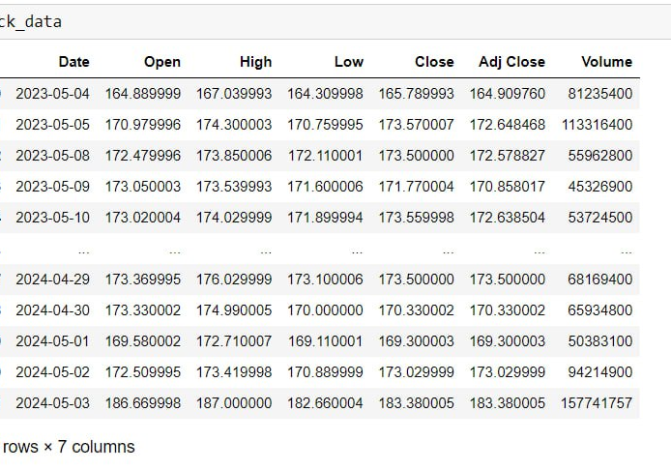
Application of Monte Carlo and Black-Scholes Methods for option pricing
Apple historical data for the last year was downloaded from Yahoo finance, data showed observations for 252 trading days and has the following variables Date, Open, High, Low, Close, Adj Close and Volume.

Slide 14

Date: This column represents the specific day on which the data was recorded. For stock market data, this is typically only the days when the stock market is open (Monday through Friday, excluding holidays).
Open: This is the price of the stock at the beginning of the trading day. It’s the first price at which a stock is traded when the exchange opens in the morning.
High: This is the highest price at which the stock traded during the trading day. It indicates the peak price level that the stock reached during the day.
Low: This is the lowest price at which the stock traded during the trading day. It shows the minimum price level the stock dropped to during the day.
Close: This is the price of the stock at the end of the trading day. It’s the last price at which the stock is traded before the market closes.
Adj Close: The ”Adjusted Close” is the closing price after adjustments for all applicable splits and dividend distributions. This is very important for analysis over long periods because it gives a more accurate reflection of the stock’s value by incorporating these financial changes.
Volume: This number indicates how many shares of the stock were traded during the day. High volume typically indicates that there is a high level of interest in the stock, and it can also mean more liquidity, which makes it easier to buy or sell the stock.

Slide 15
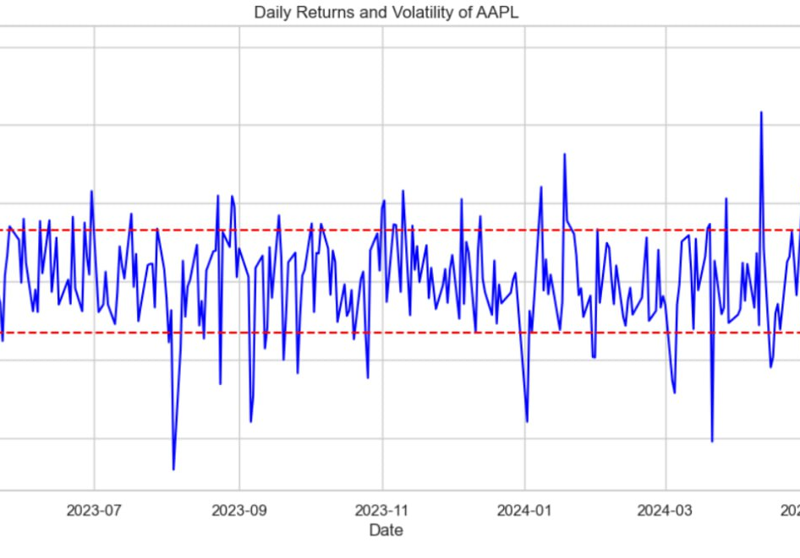
Calculating Volatility


Slide 16







Setting up new parameters
S0 (Initial Stock Price): "183.38 — based on the most recent data."
K (Strike Price): "183.38 — the price at which the option can be exercised."
T (Time to Expiration): "1 year — the duration until the option expires."
r (Risk-Free Rate): "0.01 — the theoretical rate of return of an investment with zero risk."
num_simulations: "10,000 — the number of times the stock price path will be simulated."
num_steps: "12 — corresponds to monthly steps within the one-year timeframe."
dt (Time Increment Per Step): "Calculated as T / num_steps, determining the time interval for each simulation step."

Slide 17
Monte Carlo Method Estimations
The method used 10.0000 simulations of possible stock price starting at cur- rent price, after that call and put option prices were estimated which where 16.094426870067373, 13.92511997770731 respectively.

Slide 18
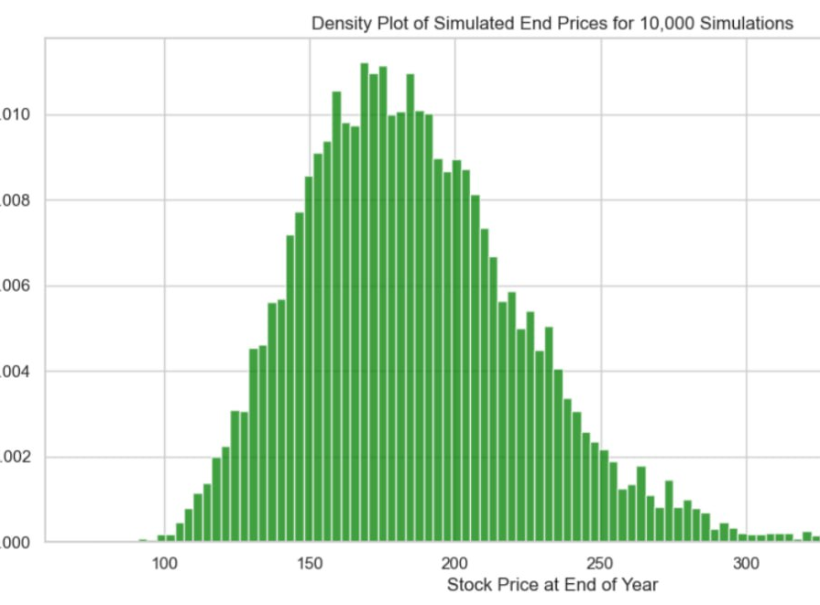

Slide 19
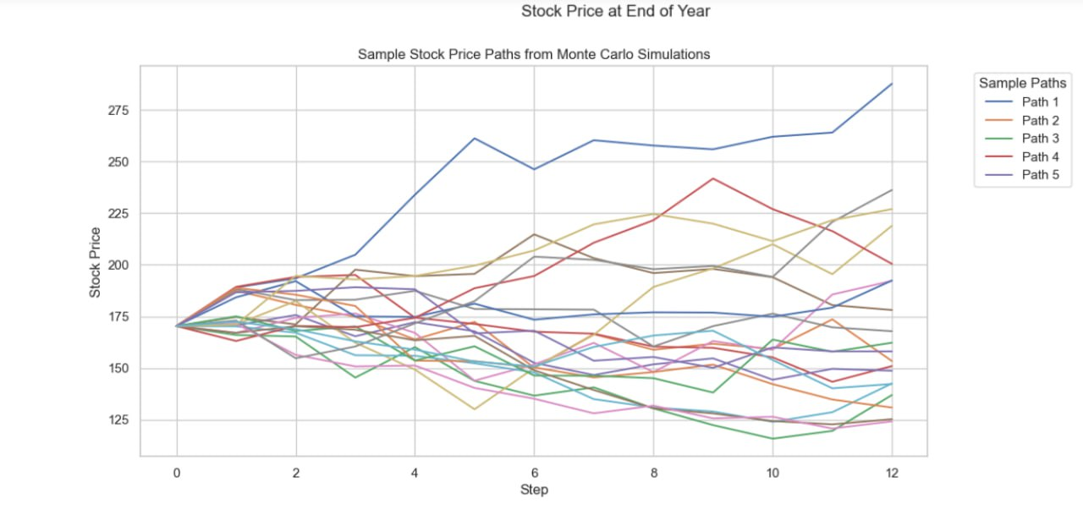

Slide 20
Black-Scholes Call Price: $15.95, Monte Carlo Call Price: $16.09
Black-Scholes Put Price: $14.12, Monte Carlo Put Price: $13.93

Slide 21
Option Pricing Analysis
Call Option Pricing
The call option price derived from the Monte Carlo simulation is marginally higher at $16.09 compared to that calculated using the Black-Scholes model ($15.95). This slight difference could be attributed to the Monte Carlo method’s ability to incorporate a range of possible price trajectories through its stochastic approach. This method is particularly sensitive to scenarios that may not adhere strictly to the log- normal distribution assumed by the Black-Scholes model, potentially accounting for higher price movements that elevate the average payoff of the call option.
Put Option Pricing
Conversely, the put option price is slightly lower in the Monte Carlo simulation ($13.93) compared to the Black-Scholes model ($14.12). This difference could be due to the Black-Scholes assumption of a continuous, log-normally distributed model of stock price movements, which might overestimate the likelihood or impact of significant downward movements (tail risk). The Monte Carlo simulation, by generating discrete paths and capturing a broader spectrum of downward movements, may provide a more tempered estimation of extreme market conditions.

Slide 22
Market Comparison
After running both Monte Carlo and Black Scholes methods, we decided to check the prices of options using the Yahoo Finance web page; even though options in exactly one year were not available, we got the prices for March 2025, which were around $20 and $19 US dollars per one share for call and put options, respectively. These numbers are a bit higher than what we got, which reflects the higher implied volatility in the market. Real-world expectations and uncertainties that theoretical models may not fully capture demonstrate the importance of continuously adjusting and calibrating models in response to current market conditions in order to align theoretical valuations with practical trading environments.

Slide 23
Control variates technique
Simulation of Payoffs
We simulate the paths of the underlying asset price using geometric Brownian motion. The simulation involves computing the payoffs for European call and put options based on these paths. This step establishes the basis for our empirical estimation, which will be adjusted using the control variates method.
Use of Black-Scholes as a Control
The theoretical prices of the options are calculated using the Black-Scholes formula. These prices serve as our control variate, providing a benchmark against which the simulation’s accuracy is measured.
Variance Reduction
The final step in our process involves adjusting the empirical mean payoffs from the simulation. We add the difference between the theoretical Black-Scholes price and the empirical mean payoff to each simulated payoff. This adjustment not only corrects any bias introduced by the randomness in the simulation paths but also stabilizes the estimates, yielding more accurate and reliable option prices with reduced variance.

Slide 24
Conclusion
The integration of control variates with Monte Carlo simulations for option pricing significantly enhances the accuracy and reliability of the results. By reducing the variance associated with random simulation paths, we provide more precise estimations that are crucial for effective decision making in financial analytics.

Slide 25
References
Metropolis, N., & Ulam, S. (1987). The Beginning of the Monte Carlo Method. Los Alamos Science.
Boyle, P. P. (1977). Options: A Monte Carlo Approach. Journal of Financial Economics, 4(3), 323-338.
Merton, R. C. (1973). Theory of Rational Option Pricing. The Bell Journal of Economics and Management Science.
Black, F., & Scholes, M. (1973). The Pricing of Options and Corporate Liabilities. Journal of Political Economy, 81(3), 637-654.
Glasserman, P. (2003). Monte Carlo Methods in Financial Engineering. Springer Science & Business Media, Volume 53.

